Slide 1
Nutrition assistant Application
Project Mentor :
Ponmalar.S Team Id : PNT2022TMID23092
Team members :
B.R.Deepak niranjan,
a.dinesh kannan,
r.nishanth,
s.muthu kamatchi.

Slide 2
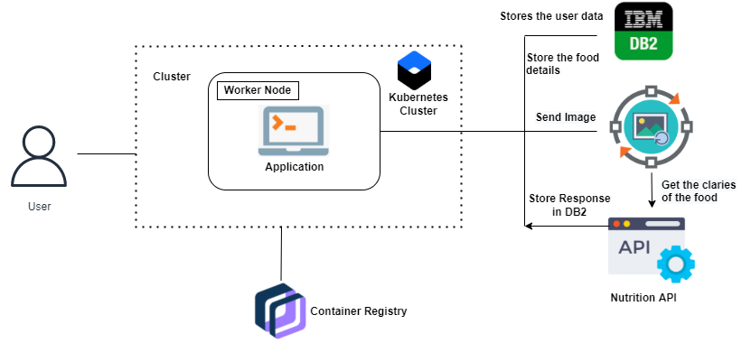
Technical Architecture

Slide 3
Problem Definition
Due to the ignorance of healthy food habits,
obesity rates are increasing at an alarming speed
this is reflective of the risks to people’s health
People need to control their daily calorie intake by eating healthier foods, which is the most basic method to avoid obesity.
However, although food packaging comes with nutrition (and calorie) labels, it’s still not very convenient for people

Slide 4
Survey Papers
Author name : kiatateeti anusornpakdee
Title : personal health assistant on android mobile device – sleeping, nutrition and exercise
Published date : march 2014
Objective : Good health can be achieved by maintaining good behaviors such as a enough exercise and good nutrition. However, the competitive environment now a days prevents such good behaviors. Thus, this work aims to develop an application on mobile devices that is able to (1) record the daily nutrition information, (2) analyze the collected information in order to provide a notification or an alarm.
Technology used : data analysis(simple data analysis method is performed ).

Slide 5
Survey Papers
Author name : joran hjelmesaeth, agneta sjoberg
Title : human body weight, nutrients and food-a scoping review
Published date : 9 june 2021
Objective : The aim of this article (scoping review) is to elucidate the current knowledge for the potential role of body weight for setting and updating Dietary Reference Values (DRVs) and Food-Based Dietary Guidelines (FBDGs). We observe that intake of specific nutrition leeds to moderate or slight change ( 0.3% – 3.0% ) in weight of human

Slide 6
Existing Application
Deveoped by : nutrismart ltd
Title : diteup-your nutrition assistant & weight loss
Publication website : google play store
Published date : 29 june 2021
Objective : Dietup is your personal virtual assistant for providing personalized diet advice and gives you all the details about local foods. Created and managed by Doctors, Nutritionists, and Software engineers, our app is trustworthy, fast, and available when and where you need it. Join the platform which got attention from different institutions such as GIZ AND RISA, Our vision is to create a better everyday life for children and caregivers

Slide 7
Existing Application
Deveoped by : zilla technologies
Title : foodzilla! Nutrition assistant
Publication website : google play store
Published date : 10 augest 2022
Objective : See nutrients, calories, vitamins and minerals by just taking pictures of your meals. Discover new healthy recipes and use filters to find the ones that fit your diet such as "Low Carb", "High Protein", "High Fat", "Low FODMAP" and more.

Slide 8
Existing Application
Critical findings :
"Cannot edit a recipe easily to change from regular bread to GF bread if someone was coeliac, need to enter the recipe from the beginning again.“
"We cannot yet send PDF versions of the meal plans to clients who have no capability to engage with the application. Issues with loss of data still occurs from time to time.“
"But the lack of meals and how to find and add was not good."

Slide 9
Existing Application
Deveoped by : livestrong
Title : myplate calorie tracker
Publication website : google play store
Published date : 05 October 2021
Objective : Tracking calories works! Join the millions who have lost weight with LIVESTRONG.COM’s MyPlate Calorie Tracker. the most user-friendly way to track your calories and stay fit on your Android Phone. LIVESTRONG.COM makes tracking calories EASY.

Slide 10
Existing Application
Deveoped by : platejoy,inc.
Title : platejoy
Publication website : google play store
Published date : 28 july 2022
Objective : Healthy eating, simplified. Achieve your health & fitness goals with custom-designed meal plans and grocery lists tailored to youPersonalized meal plans for any lifestyle: Paleo, Gluten Free, Weight Loss, Kid Friendly, Vegetarian, Vegan, Low Carb, Low Fat, Prediabetic, and more.

Slide 11
Existing Application
Deveoped by : myfitnesspal, inc.
Title : myfitnesspal : calorie counter
Publication website : google play store
Published date : 30 augest 2022
Objective : Track progress toward your nutrition, fitness, weight loss and water goals with MyFitnessPal. This all-in-one food tracker and health app is like having a nutrition coach, meal planner, and food diary with you at all times. MyFitnessPal isn’t another restrictive diet app. This is a health app to help you learn about your habits.

Slide 12
Existing Application
Critical findings :
People often misreport
Correct calories/macros not always available
Disappointing on more adds taken over the app
The premium version is too expensive
Time consuming

Slide 13
Existing Application
Deveoped by : lifesum
Title : lifesum : healthy eating & diet
Publication website : google play store
Published date : 24 augest 2022
Objective : Meal plans, food diary, macro calculator, nutrition tracker, calorie counter and healthy recipes, all in one convenient place. Eat healthy and feel great with Lifesum! Looking to try a keto, fasting, paleo or sugar free diet? We have the perfect diet for any goal. Need a health tracker to stay in check? Fear not. We've got an intuitive food diary, macro calculator and tons of nutritional guidance.

Slide 14
Existing Application
Critical findings :
Scanning the barcode gets incorrect information
Often the pages goes blank
calorie counts on certain product are just wrong
There is no nutritionist

Slide 15
Existing Application
Deveoped by : maple media
Title : calorie counter app : fooducate
Publication website : google play store
Published date : 31 augest 2022
Objective : Fooducate is designed to help you lose weight and keep it off. Fooducate also helps you find and understand which foods are healthiest, with detailed and up-to-date nutrition and ingredient information. With Fooducate, you can track your calories, macros, and workouts, plus get motivated, share diet tips and recipes with a community of health and wellness enthusiasts. Download the app & start your journey today!

Slide 16
Existing Application
Critical finding :
Some report of the barcode scanner not working on certain Samsung models.
calorie counts on certain product are just wrong
Correct calories/macros not always available
But the lack of meals and how to find and add was not good.

Slide 17
Existing Application
Deveoped by : Mynetdiary.com
Title : calorie counter – mynetdiary
Publication website : app store
Published date : 28 augest 2022
Objective : Are you looking for a calorie counter, food log, macros tracker, or a comprehensive and effective diet plan? Meet MyNetDiary - sleek, smart, simple. It's the most personal weight-loss, diet, and nutrition assistant. Ranked #1 in Best Calorie Counter Apps of 2022 by Forbes Health, ahead of all other diet apps. Selected by Today's Dietitian Magazine for its Popular Weight Loss Apps list alongside WW and Noom.

Slide 18
Hardware & Software Requirements
Software required :
- python
- flask
- docker
System required :
- 8GB ram
- intel core i3
- os : windows / mac / linux
- laptop / desktop

Slide 19
Thank you…!

